Slide 1

Language Translation with LSTM- RNN
-By
Bhavani Mediga

Slide 2
Content
Problem Statement
Datasets
Preparation
Parameters
Demo
Usage
Future Scope

Slide 3
Problem Statement
Language translation, crucial for global communication, undergoes a profound shift with deep learning technology.
Neural Machine Translation (NMT) stands out, utilizing vast multilingual data to capture nuances, grammar, and semantic structures.
This revolution enhances translation accuracy, efficiency, and accessibility, resulting in high-quality outputs resembling human-produced text.

Slide 4
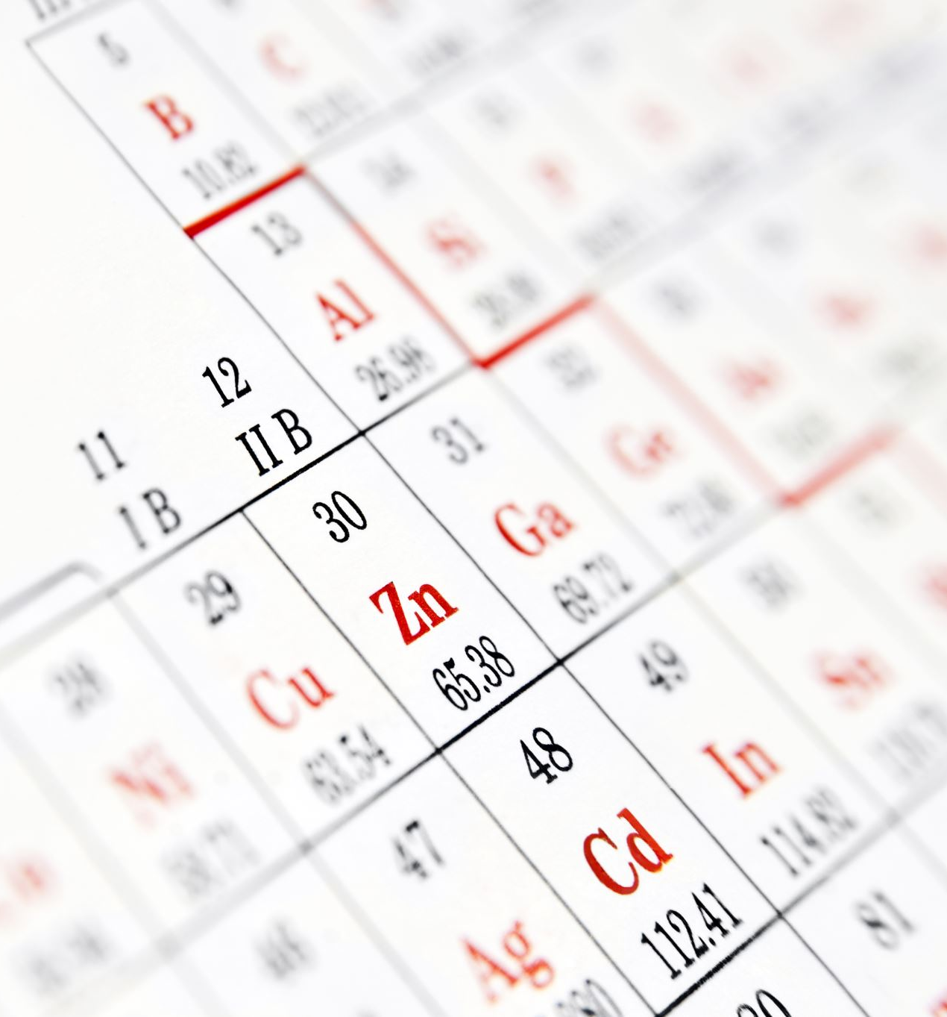
Datasets
We choose to translate English to Hindi (Official Language in India). However, the system is general and accepts any other language pair (e.g. English/French). We use ANKI dataset which can be easily downloaded.
Total number of cells- 2979
Total number of English words- 18,463
Total number of Hindi words- 20,344
Source- https://www.manythings.org/anki/

Slide 5




Preparation
TRAINING 80%
TOKENIZATION
VALIDATION 20%
PADDING

Slide 6
Parameters
Embedding Dimension: 512
LSTM Units: 512
Epochs: 50
Batch Size: 1
Optimizer: Adam
Loss Function: Categorical Crossentropy
Activation Function: SOFTMAX

Slide 7
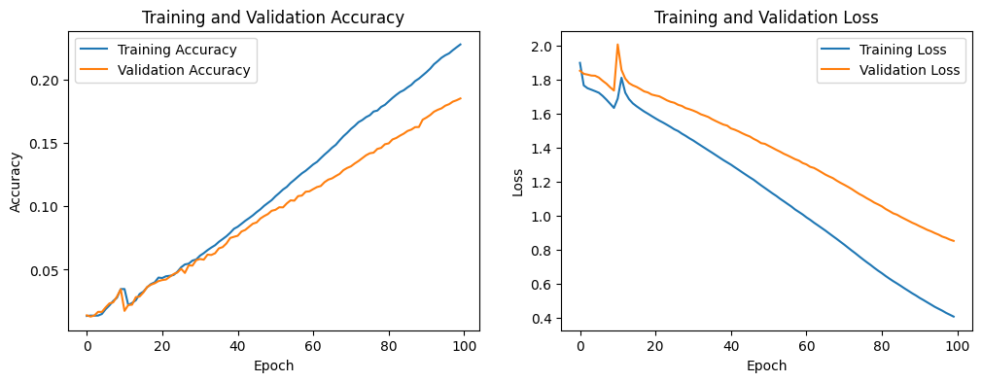

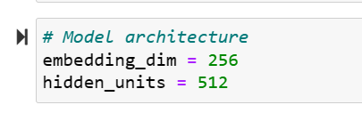
Language Translation Demo
MODEL-1
Model 1 lays the foundation for language translation development, employing LSTM layers for the encoder and decoder.
Special tokens ("<start>", "<end>") are ensured in the target tokenizer vocabulary.
Observations
Upon examination, it is evident that the model is struggling with low accuracy and exhibits signs of overfitting.
During testing, the model fails to properly interpret the dataset, resulting in an inability to read individual cells.
The testing outputs are inconsistent, producing seemingly random cell predictions.

Slide 8
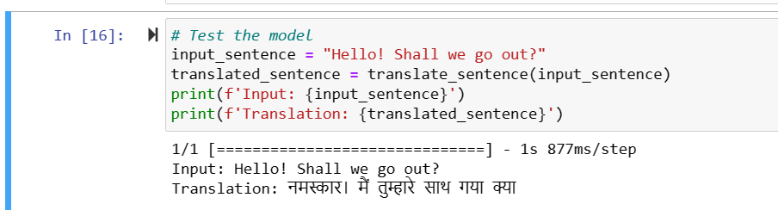
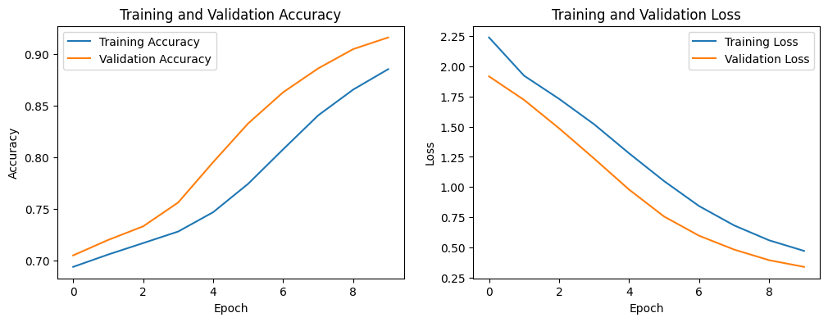
Language Translation Demo
MODEL-2
Tokenization introduces a special <OOV> token to represent unseen words in the vocabulary, ensuring the model's adaptability to out-of-vocabulary terms.
Observations-
Successfully reading individual words from the dataset and cells.
The model encountered challenges when attempting to comprehend complete sentences, especially when combining two or more words.

Slide 9
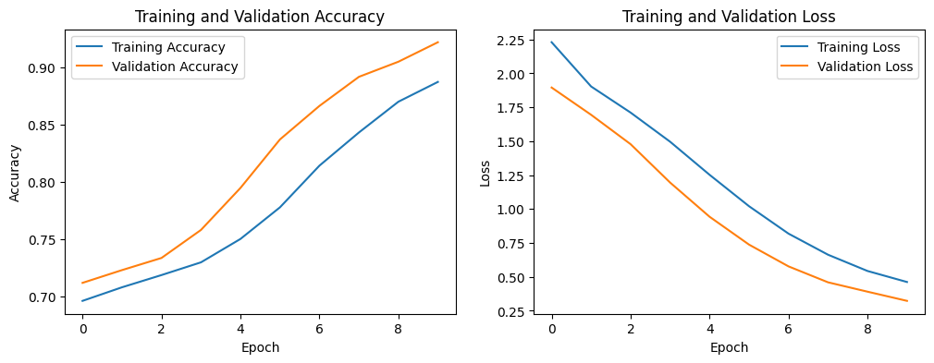
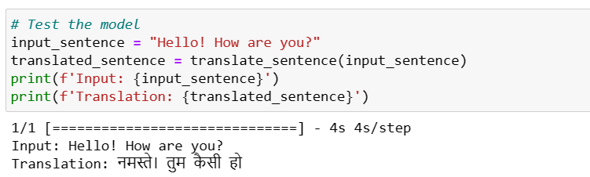
Language Translation Demo
MODEL-3
Further, we proceeded to run the model after cleansing the dataset by eliminating punctuation.
Observations
Read the dataset properly.
Read the cells properly.
Interpreted sentences but not punctuation in our output.

Slide 10
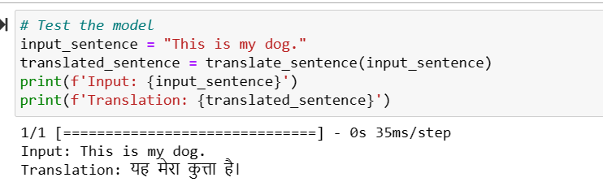

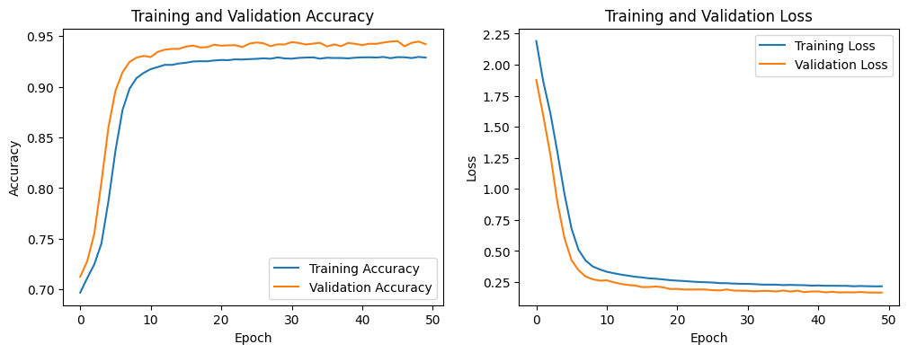
Language Translation Demo
MODEL-4
Increase LSTM layers to 512, epoch to 50.
Outcomes of the model-
Ensure a thorough reading of the dataset.
Accurately read and process individual cells.
Enhance sentence interpretation compared to the previous model, and include proper punctuation in our output.

Slide 11
Usage
The Language Translation using Deep Learning project has a wide range of applications in a variety of disciplines.
One important use is in global corporate communication, where precise and context-aware translations may improve collaboration and understanding among multinational partners.
In the field of education, the initiative can help students understand the meaning of words or phrases in their original language by giving quick translations and explanations.
Content providers may benefit from effective translation services, which allow them to modify their work for worldwide audiences while maintaining the intended message.

Slide 12
Future Scope
To introduce new languages and to assist people all around the world.
To build a front end and keep it available for the public to utilize.
To design an app that can assist individuals with language translation.

Slide 13
Thank You!

